Slide 1
Society Management System.
(Web-Application)
Name : Bhakti Desai
Sap Id : 53003160012
Guide : Miss. Sareeta Mugde

Slide 2
Abstract:
Since India is moving to digital India. In society, we stay have decided to go digital. So I decided to build an web application which would help all society members in just a click.
Its features can be chatting with society members. , conducting meetings via forums , displaying emergency & household contact numbers , booking of auditorium , broadcasting notice.
This web application can manage complex professionally with processes supported by tools, than being person dependent.

Slide 3
Existing System:
The existing system is slow and takes time to retrieve and save data in the database.
As various types of registers are maintained it is easy to record the data in each separate book but it is very difficult to retrieve the integrated output data record from these.
It is very time consuming and there are problems in creating bill which was done manually. So there were many chances of errors and data redundancy.

Slide 4
Proposed System:
The main objective of this system is to maintain data of society/complex from one place instead of manually maintaining records.
Manage complex professionally with processes supported by tools, than being person dependent.
The key idea of this project is giving members the update of what’s happening in the society and bills generation.

Slide 5
Achievements:
Improved utilization of manpower. Because of computerized generation, it considerably reduces the human efforts required for generating reports.
Fast and accurate bill generation.
System is user friendly.
Eliminates the need of bill book .
Maintains the members details too.
Errors are properly responded by user friendly message box.
It saves time and fast communication is possible.
Systematic storage and easy access of data.
Adding, deleting and modifying are very easy.
Discussion of certain topic can be done through forum.

Slide 6
Technologies Used:
C# : C# is a multi-paradigm programming language encompassing strong typing, imperative, declarative, functional, generic, object-oriented, and component-oriented programming disciplines. It was developed by Microsoft within its .NET initiative. C# is one of the programming languages designed for the Common Language Infrastructure.
ASP.net : ASP.net is a server-side Web application framework designed for Web development to produce dynamic Web pages. It was developed by Microsoft to allow programmers to build dynamic web sites, web applications and web services.

Slide 7
Microsoft SQL Server :Microsoft SQL Server is a relational database management system developed by Microsoft. As a database, it is a software product whose primary function is to store and retrieve data as requested by other software applications, be it those on the same computer or those running on another computer across a network (including the Internet). There are at least a dozen different editions of Microsoft SQL Server aimed at different audiences and for different workloads (ranging from small applications that store and retrieve data on the same computer, to millions of users and computers that access huge amounts of data from the Internet at the same time). Its primary query languages are T-SQL and ANSI SQL.
Also ,the project accommodates the use of HTML, CSS.

Slide 8
Software Model Used:
Spiral model is a combination of both, iterative model and one of the SDLC model.
It can be seen as if you choose one SDLC model and combined it with cyclic process (iterative model).
This model considers risk, which often goes un-noticed by most other models.
The model starts with determining objectives and constraints of the software at the start of one iteration.
Next phase is of prototyping the software. This includes risk analysis.
Then one standard SDLC model is used to build the software. In the fourth phase of the plan of next iteration is prepared.

Slide 9
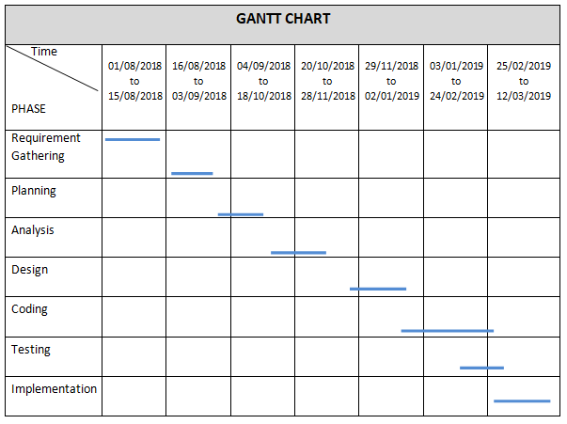
Gantt Chart:
It is the Graphical Representation about the progress of the project. It displays the details about how much time is taken for any task.

Slide 10
Software and Hardware Requirements:
1. Hardware Specification for modeled System
5 GB of Hard Disk
512 MB RAM (minimum)
Processor type P-IV or onwards
2. Software Specification for modeled System
Windows 7 or Above
Front-End ASP.Net, C#
Back-end Microsoft SQL Server

Slide 11
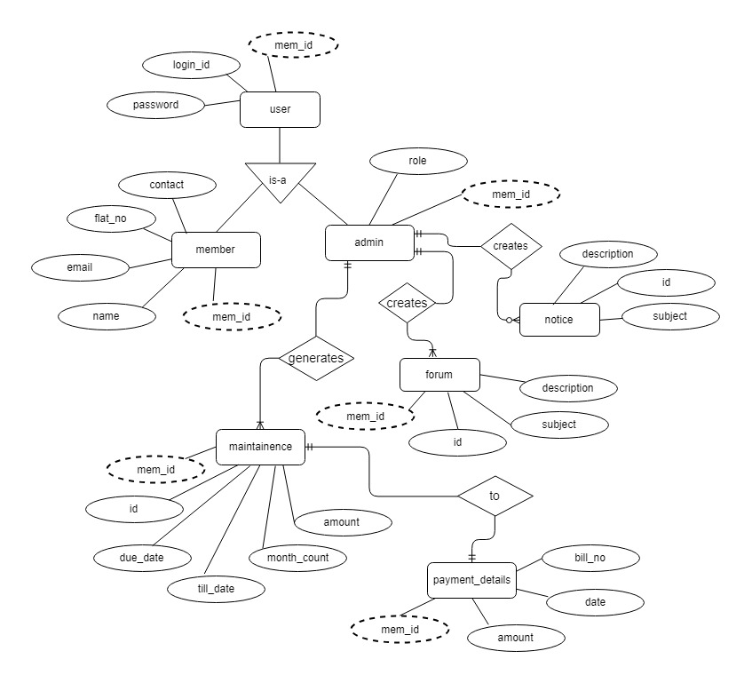
ER diagram:

Slide 12
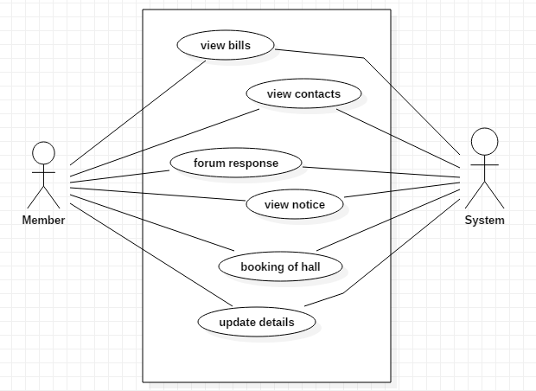
Use Case Diagram:
1)

Slide 13
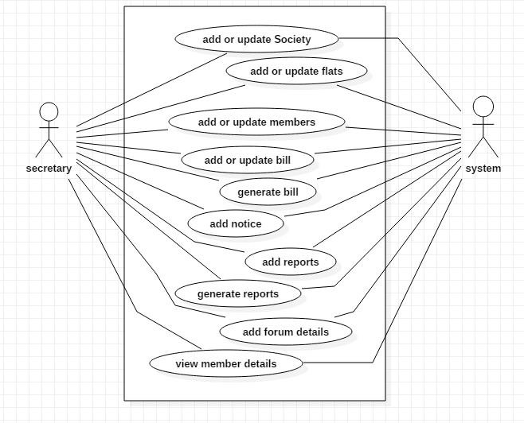
2)

Slide 14
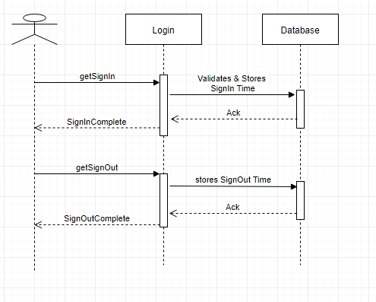
Sequence Diagram:

Slide 15
Data Set:
1) Member :
2) User:
3) Admin:
Field Name | Data Type | Data Format | Field Size | Description | Example
mem_id [PK] | Integer | NNNNNN | 6 | unique number id for all members | 12345
first name | Text |  | 30 | first name of member | Bhakti
surname | Text |  | 30 | surname of member | Desai
flat no | Text |  | 10 | flat no. & wing of member | C/101
Phone No. | Text |  | 15 | member's contact number | 9876543210
Email-Id | Text |  | 30 | member's email id | abc@gmail.com
Field Name | Data Type | Data Format | Field Size | Description | Example
mem_id [FK] | Integer | NNNNNN | 6 | unique number id for all members | 12345
role | Text |  | 30 | specifies whether he is secretary/committee member | secreatry
Field Name | Data Type | Data Format | Field Size | Description | Example
mem_id [FK] | Integer | NNNNNN | 6 | unique number id for all members | 12345
login_id | Text |  | 10 | unique login id for all members | b12

Slide 16
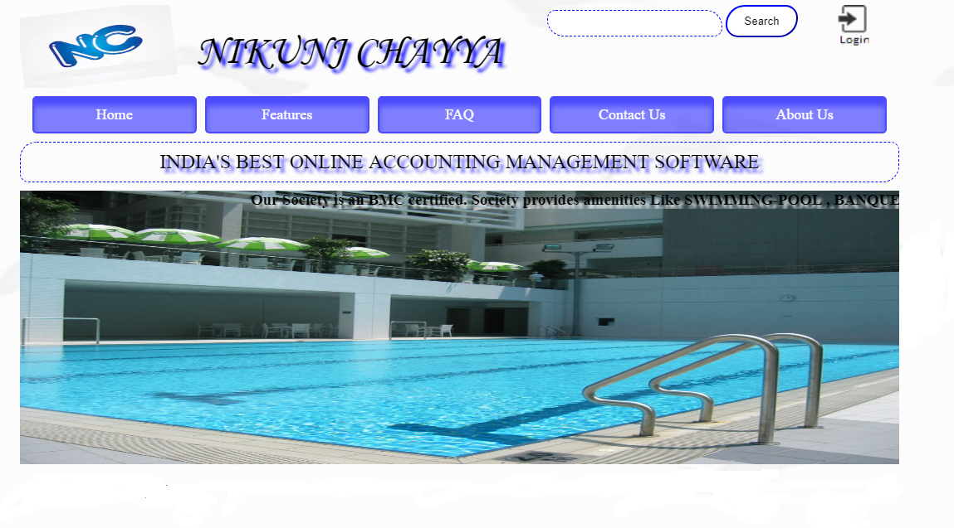
Home Page Design:

Slide 17
Testing:
To check whether the system is working neatly and error free. Four different types of testing are:
UNIT TESTING
MODULE TESTING
INTEGRATED TESTING
SYSTEM TESTING

Slide 18
Unit Testing : Unit testing is very important in testing of the project, from the name itself, we come to know that it checks the system unit wise.
Module Testing: For Systematic Progressive testing, we will adopt the modular approach. The system is tested to check if all fields works together and produce as per the stated rules and regulations without affecting the tested during change. Each and every module is tested during programming stage.

Slide 19
Integrated Testing: All modules are integrated and combined to carry out module testing and check the following:
After the proper option, the particular module should be called.
When the called module is terminated, the control should go back to the main form.
The integrated testing check the control flow goes as per the decided flow.
System Testing: In system testing, whole system is checked for whether the system is giving correct output as per the given expectation. It is the last stage therefore it is implemented for this a testing plan is necessary that will aid to maximize the effectiveness of discovering errors.

Slide 20
Limitations of Existing System:
The current system is manual system where the maintenance calculation, which is a complex process, has to be done manually.
The receipt about the society members are to be generated manually and then get it printed by the secretary.
The time consumed for the processing current system is a lot. The data about the members is done manually.

Slide 21
Future Scope:
Parking assessment
Visitors tracking
Attendance of watchman
Payment of Bill through Debit/Credit Cards.

Slide 22
Conclusion:
Society management system puts forth the actual working of a society. Administration, working, etc. similar to a society are the key features of my project. User can access feeds and news from the society anywhere and anytime for their own comfort.

Slide 23

References:
From Client :
Nikunj Chayya – Co-operative Housing Society, Kandivali-West.

Slide 24
Other References:
documentation of senior’s project.
Maharashtra Co-operative Housing Societies Act; [MCS Act] 1960.
Nevonprojects.com
Crystal Reports.com
Microsoft sql server documentation

Slide 25
Thank You!

